Slide 1
Web IR: Recent Trends; Future of Web Search
CSC 575
Intelligent Information Retrieval

Slide 2
Behavior-Based Ranking
Emergence of large-scale search engines allow for mining aggregate behavior analysis to improving ranking.
Basic Idea:
For each query Q, keep track of which docs in the results are clicked on
On subsequent requests for Q, re-order docs in results based on click-throughs.
Relevance assessment based on
Behavior/usage
vs. content

Slide 3
Query-doc popularity matrix B
Docs
j
q
Queries
B_{qj} = number of times doc j
clicked-through on query q
When query q issued again, order docs by B_{qj} values.
Notes:
Naïve implementation

Slide 4
Vector space implementation
Maintain a term-doc popularity matrix C
as opposed to query-doc popularity
initialized to all zeros
Each column represents a doc j
If doc j clicked on for query q, update C_{j}← C_{j} +ε q (here q is viewed as a vector).
On a query q’, compute its cosine proximity to C_{j} for all j.
Combine this with the regular text score.

Slide 5
Issues
Normalization of C_{j} after updating
Assumption of query compositionality
“white house” document popularity derived from “white” and “house”
Updating - live or batch?
Basic assumption:
Relevance can be directly measured by number of click throughs
Valid?

Slide 6
“Information retrieval”
The name “information retrieval” is standard, but as traditionally practiced, it’s not really right
All you get is document retrieval, and beyond that the job is up to you
Which technologies will help us get closer to the real promise of IR?

Slide 7
Learning interface agents
Add agents to the user interface and delegate tasks to them
Use machine learning to improve performance
learn user behavior, preferences
Useful when:
1) past behavior is a useful predictor of the future behavior
2) wide variety of behaviors amongst users
Examples:
mail clerk: sort incoming messages in right mailboxes
calendar manager: automatically schedule meeting times?
Personal news agents
portfolio manager agents
Advantages:
less work for user and application writer
adaptive behavior
user and agent build trust relationship gradually

Slide 8
Letizia: Autonomous Interface Agent (Lieberman 96)
user
letizia
heuristics
recommendations
user profile
Recommends web pages during browsing based on user profile
Learns user profile using simple heuristics
Passive observation, recommend on request
Provides relative ordering of link interestingness
Assumes recommendations “near” current page are more valuable than others

Slide 9
Letizia: Autonomous Interface Agent
Infers user preferences from behavior
Interesting pages
record in hot list (save as a file)
follow several links from pages
returning several times to a document
Not Interesting
spend a short time on document
return to previous document without following links
passing over a link to document (selecting links above and below document)
Why is this useful
tracks and learns user behavior, provides user “context” to the application (browsing)
completely passive: no work for the user
useful when user doesn’t know where to go
no modifications to application: Letizia interposes between the Web and browser

Slide 10
Consequences of passiveness
Weak heuristics
example: click through multiple uninteresting pages en route to interestingness
example: user browses to uninteresting page, then goes for a coffee
example: hierarchies tend to get more hits near root
Cold start
No ability to fine tune profile or express interest without visiting “appropriate” pages
Some possible alternative/extensions to internally maintained profiles:
expose to the user (e.g. fine tune profile) ?
expose to other users/agents (e.g. collaborative filtering)?
expose to web server (e.g. cnn.com custom news)?

Slide 11
ARCH: Adaptive Agent for Retrieval Based on Concept Hierarchies (Mobasher, Sieg, Burke 2003-2007)
ARCH supports users in formulating effective search queries starting with users’ poorly designed keyword queries
Essence of the system is to incorporate domain-specific concept hierarchies with interactive query formulation
Query enhancement in ARCH uses two mutually-supporting techniques:
Semantic – using a concept hierarchy to interactively disambiguate and expand queries
Behavioral – observing user’s past browsing behavior for user profiling and automatic query enhancement

Slide 12
Overview of ARCH
The system consists of an offline and an online component
Offline component:
Handles the learning of the concept hierarchy
Handles the learning of the user profiles
Online component:
Displays the concept hierarchy to the user
Allows the user to select/deselect nodes
Generates the enhanced query based on the user’s interaction with the concept hierarchy

Slide 13
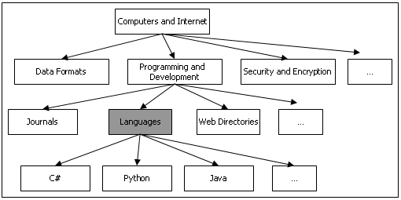
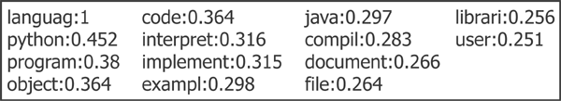
Offline Component - Learning the Concept Hierarchy
Maintain aggregate representation of the concept hierarchy
pre-compute the term vectors for each node in the hierarchy
Concept classification hierarchy - Yahoo

Slide 14
Aggregate Representation of Nodes in the Hierarchy
A node is represented as a weighted term vector:
centroid of all documents and subcategories indexed under the node
n = node in the concept hierarchy
D_{n} = collection of individual documents
S_{n} = subcategories under n
T_{d} = weighted term vector for document d indexed under node n
T_{s} = the term vector for subcategory s of node n

Slide 15
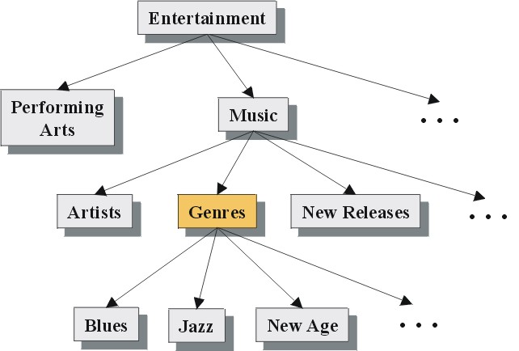
Example from Yahoo Hierarchy

Slide 16
Online Component – User Interaction with Hierarchy
The initial user query is mapped to the relevant portions of hierarchy
user enters a keyword query
system matches the term vectors representing each node in the hierarchy with the keyword query
nodes which exceed a similarity threshold are displayed to the user, along with other adjacent nodes.
Semi-automatic derivation of user context
ambiguous keyword might cause the system to display several different portions of the hierarchy
user selects categories which are relevant to the intended query, and deselects categories which are not

Slide 17
Generating the Enhanced Query
Based on an adaptation of Rocchio's method for relevance feedback
Using the selected and deselected nodes, the system produces a refined query Q₂:
each T_{sel} is a term vector for one of the nodes selected by the user,
each T_{desel} is a term vector for one of the deselected nodes
factors α, β, and γ are tuning parameters representing the relative weights associated with the initial query, positive feedback, and negative feedback, respectively such that α + β - γ = 1.

Slide 18
An Example
+
Music
Initial Query
“music, jazz”
Selected Categories
Artists
Genres
New Releases
“Music”, “jazz”, “Dixieland”
-
. . .
Deselected Category
Blues
+
Jazz
New Age
“Blues”
+
Dixieland
. . .
Portion of the resulting term vector:
music: 1.00, jazz: 0.44, dixieland: 0.20, tradition: 0.11,
band: 0.10, inform: 0.10, new: 0.07, artist: 0.06

Slide 19
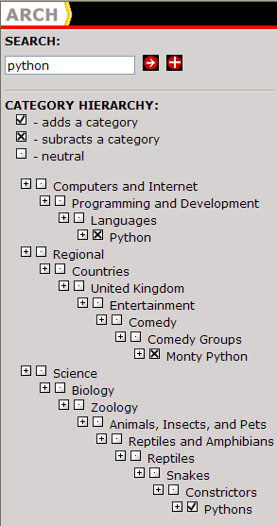
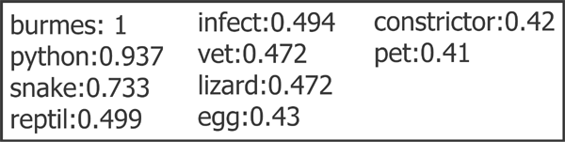
Another Example – ARCH Interface
Initial query = python
Intent for search = python as a snake
User selects Pythons under Reptiles
User deselects Python under Programming and Development and Monty Python under Entertainment
Enhanced query:

Slide 20
Generation of User Profiles
Profile Generation Component of ARCH
passively observe user’s browsing behavior
use heuristics to determine which pages user finds “interesting”
time spent on the page (or similar pages)
frequency of visit to the page or the site
other factors, e.g., bookmarking a page, etc.
implemented as a client-side proxy server
Clustering of “Interesting” Documents
ARCH extracts feature vectors for each profile document
documents are clustered into semantically related categories
we use a clustering algorithm that supports overlapping categories to capture relationships across clusters
algorithms: overlapping version of k-means; hypergraph partitioning
profiles are the significant features in the centroid of each cluster

Slide 21
User Profiles & Information Context
Can user profiles replace the need for user interaction?
Instead of explicit user feedback, the user profiles are used for the selection and deselection of concepts
Each individual profile is compared to the original user query for similarity
Those profiles which satisfy a similarity threshold are then compared to the matching nodes in the concept hierarchy
matching nodes include those that exceeded a similarity threshold when compared to the user’s original keyword query.
The node with the highest similarity score is used for automatic selection; nodes with relatively low similarity scores are used for automatic deselection

Slide 22
Results Based on User Profiles

Slide 23
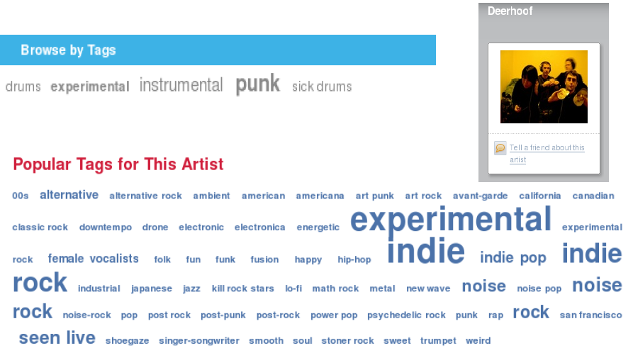
New Paradigms for Search: Social / Collaborative Tags

Slide 24
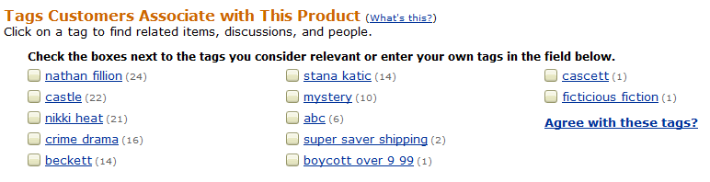

Example: Tags describe the Resource
Tags can describe
The resource (genre, actors, etc)
Organizational (toRead)
Subjective (awesome)
Ownership (abc)
etc

Slide 25
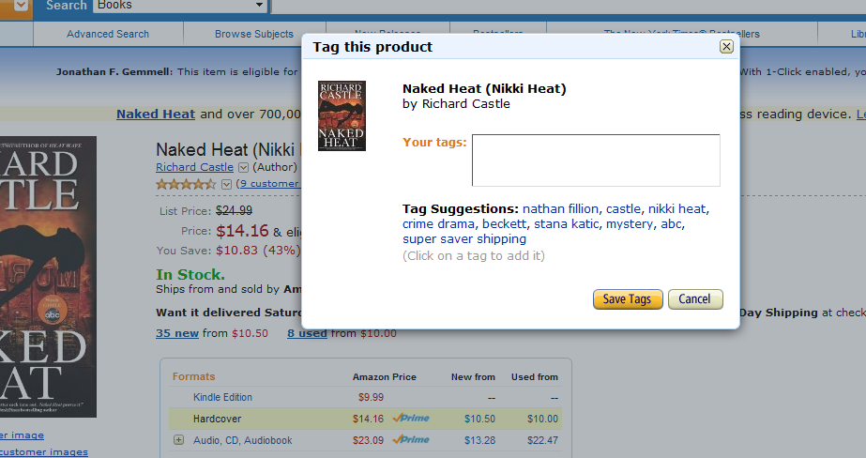
Tag Recommendation

Slide 26
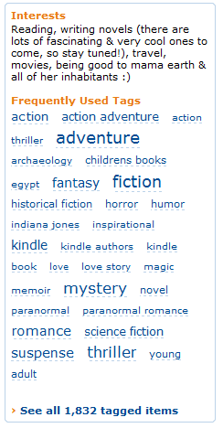
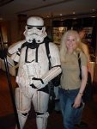

Tags describe the user
These systems are “collaborative.”
Recommendation / Analytics based on the “wisdom of crowds.”
Rai Aren's profile
co-author
“Secret of the Sands"

Slide 27
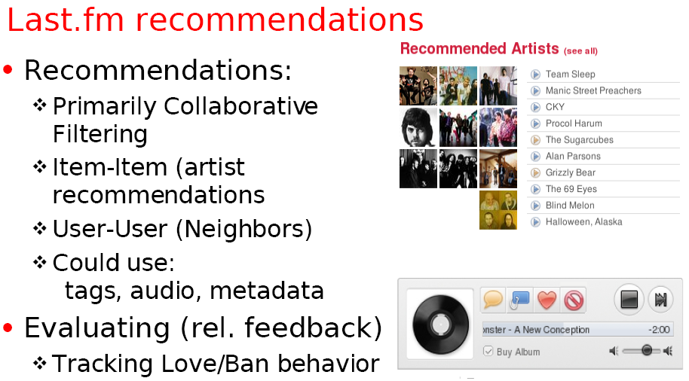
Example: Using Tags for Recommendation

Slide 28

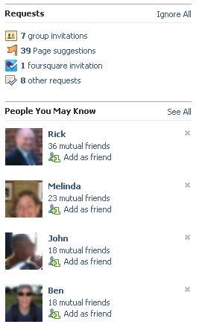
New Paradigms for Search: Social Recommendation
A form of collaborative filtering using social network data
Users profiles represented as sets of links to other nodes (users or items) in the network
Prediction problem: infer a currently non-existent link in the network

Slide 29
What’s been happening now? (Google)
“Mobilegeddon” (Apr 21, 2015):
“Mobile friendliness” as a major ranking signal
“Pigeon” update (July 2014):
For U.S. English results, the “Pigeon Update” is a new algorithm to provide more useful, relevant and accurate local search results that are tied more closely to traditional web search ranking signals
More use of distance and location in ranking signals
“App Indexing” (Android, iOS support May 2015)
Search results can take you to an app
Why?
About half of all searches are now from mobile
Making/wanting good changes, but obvious self-interest in trying to keep people using mobile web rather than apps

Slide 30
What’s been happening now? (Google)
New search index at Google: “Hummingbird”
http://www.forbes.com/sites/roberthof/2013/09/26/google-just-revamped-search-to-handle-your-long-questions/
Answering long, “natural language” questions better
Partly to deal with spoken queries on mobile
More use of the Google Knowledge Graph
Concepts versus words

Slide 31
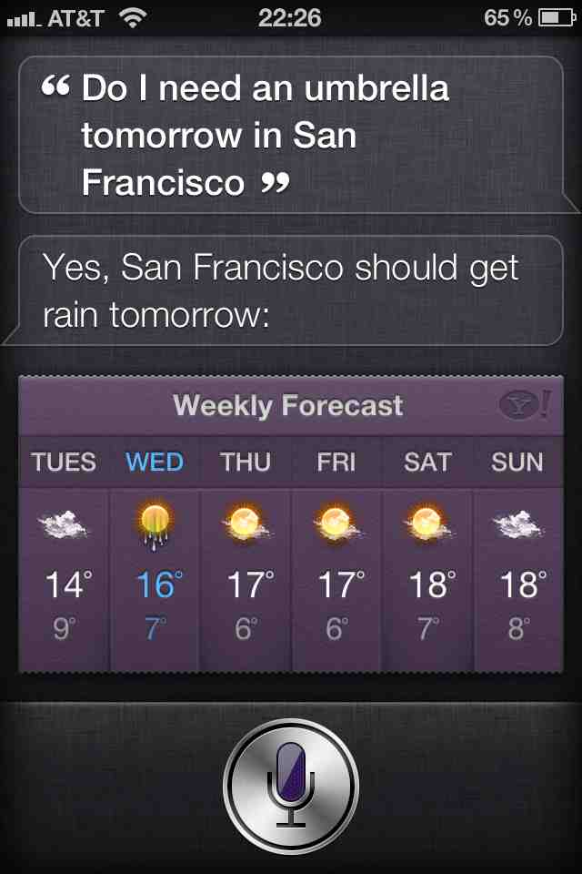
What’s been happening now?
Move to mobile favors a move to speech which favors “natural language information search”
Will we move to a time when over half of searches are spoken?

Slide 32
3 approaches to question answering: Knowledge-based approaches (Siri)
Build a semantic representation of the query
Times, dates, locations, entities, numeric quantities
Map from this semantics to query structured data or resources
Geospatial databases
Ontologies (Wikipedia infoboxes, dbPedia, WordNet, Yago)
Restaurant review sources and reservation services
Scientific databases
Wolfram Alpha

Slide 33
Text-based (mainly factoid) QA
Question Processing
Detect question type, answer type, focus, relations
Formulate queries to send to a search engine
Passage Retrieval
Retrieve ranked documents
Break into suitable passages and re-rank
Answer Processing
Extract candidate answers (as named entities)
Rank candidates
using evidence from relations in the text and external sources
Notes:
Do analysis on the fly. Have exact context.
Not good for aggregate questions or information integration.

Slide 34
Hybrid approaches (IBM Watson)
Build a shallow semantic representation of the query
Generate answer candidates using IR methods
Augmented with ontologies and semi-structured data
Score each candidate using richer knowledge sources
Geospatial databases
Temporal reasoning
Taxonomical classification

Slide 35
What’s been happening now?
Google Knowledge Graph
Facebook Graph Search
Bing’s Satori
Things like Wolfram Alpha
Common theme: Doing graph search over structured knowledge rather than traditional text search
Two Goals:
Things not strings
Inference not search

Slide 36
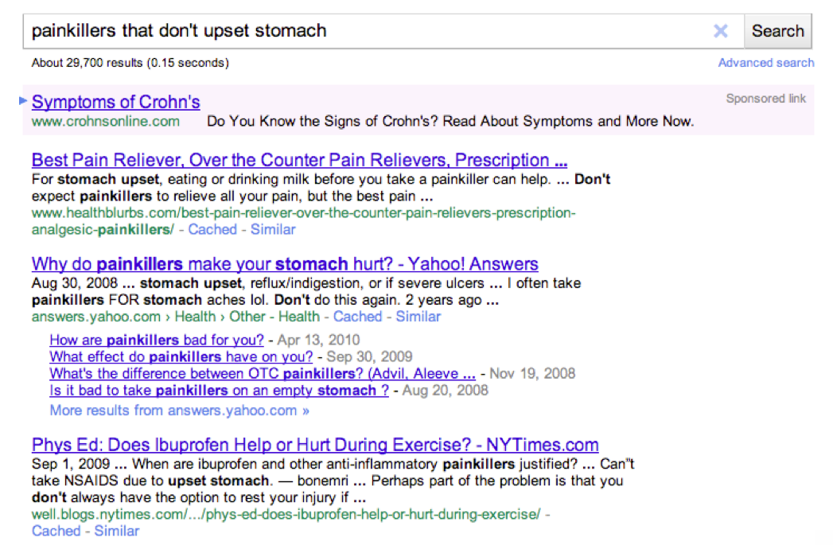
Example from Fernando Pereira (Google)

Slide 37
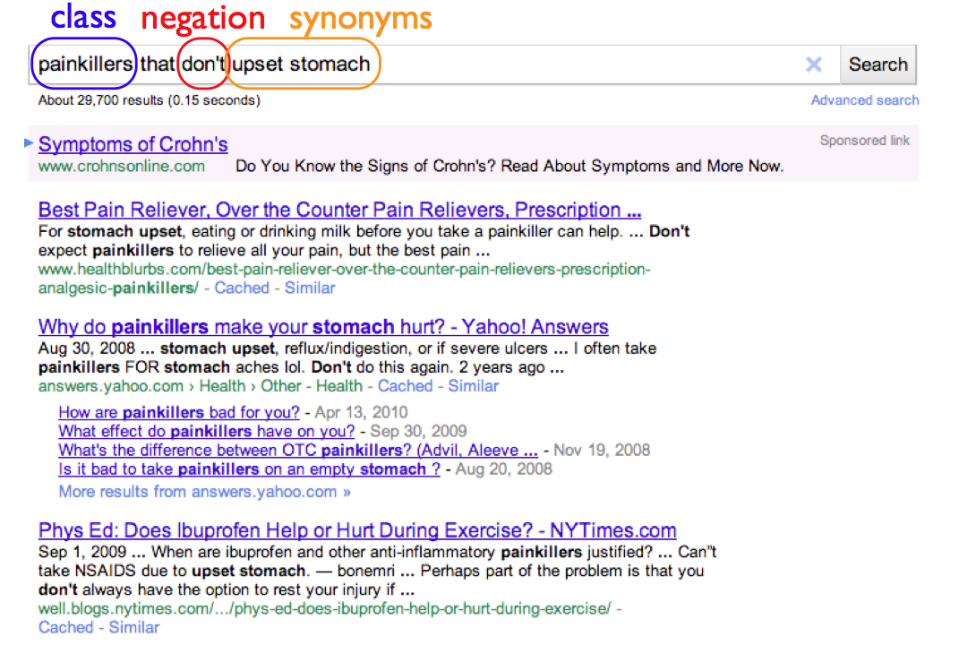

Slide 38
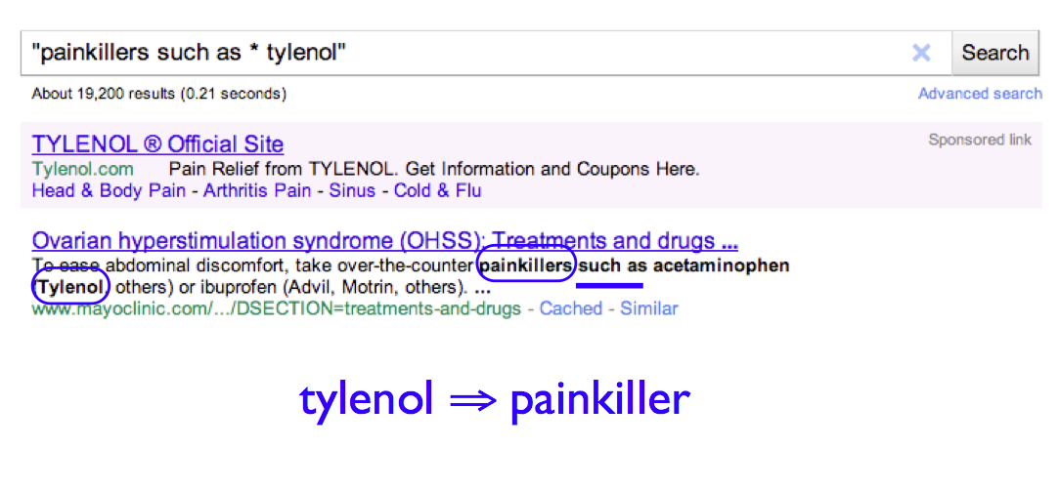

Slide 39
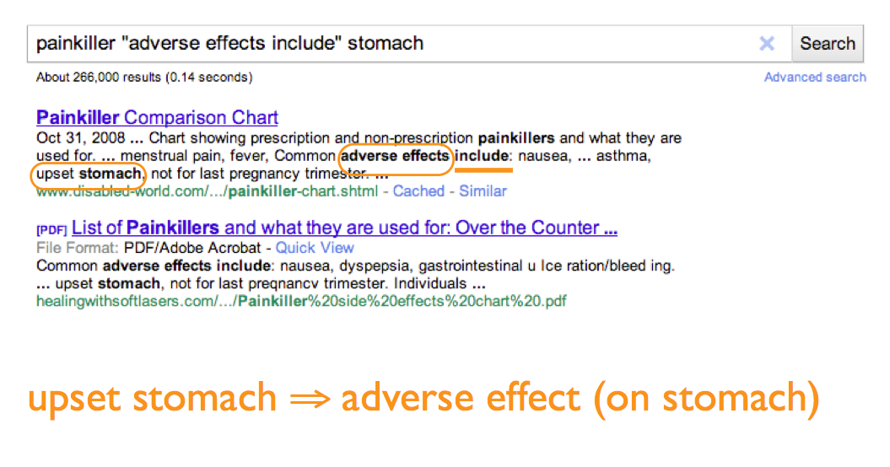

Slide 40
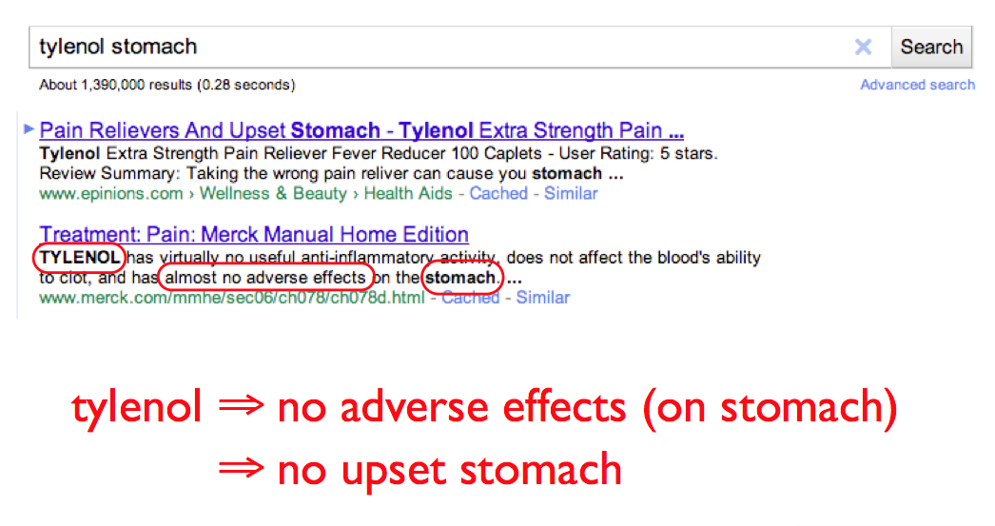

Slide 41


Slide 42
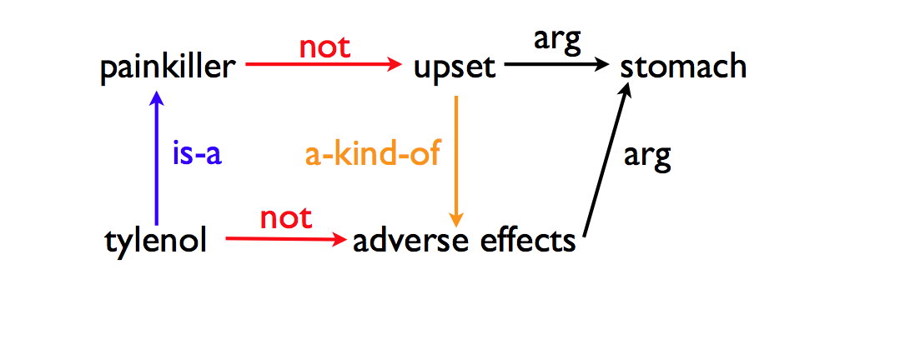

Slide 43
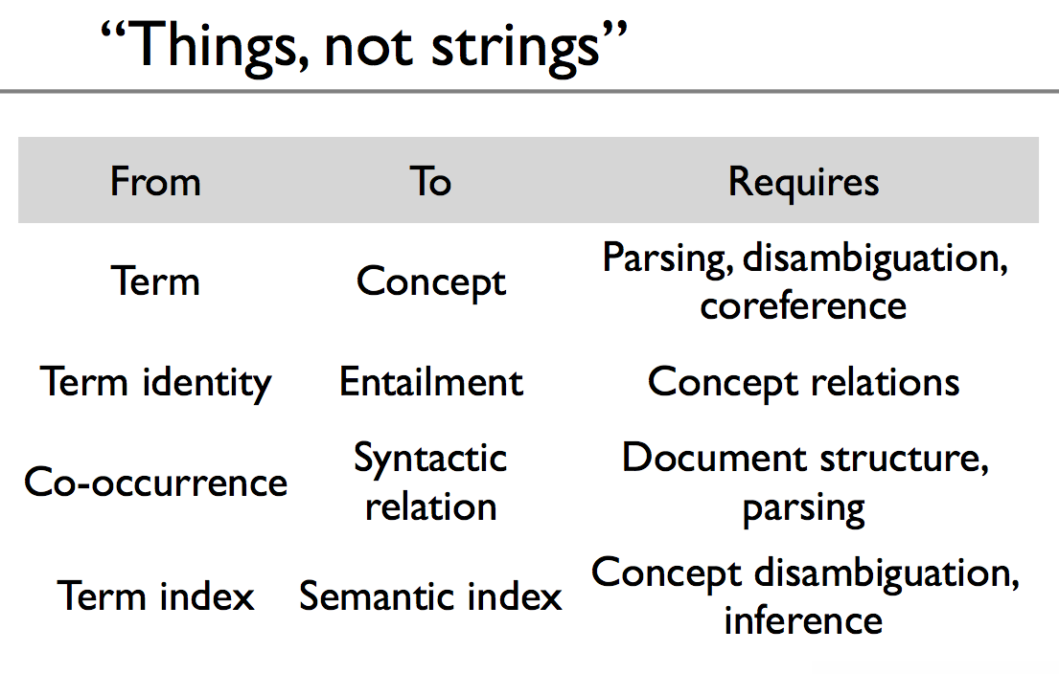

Slide 44
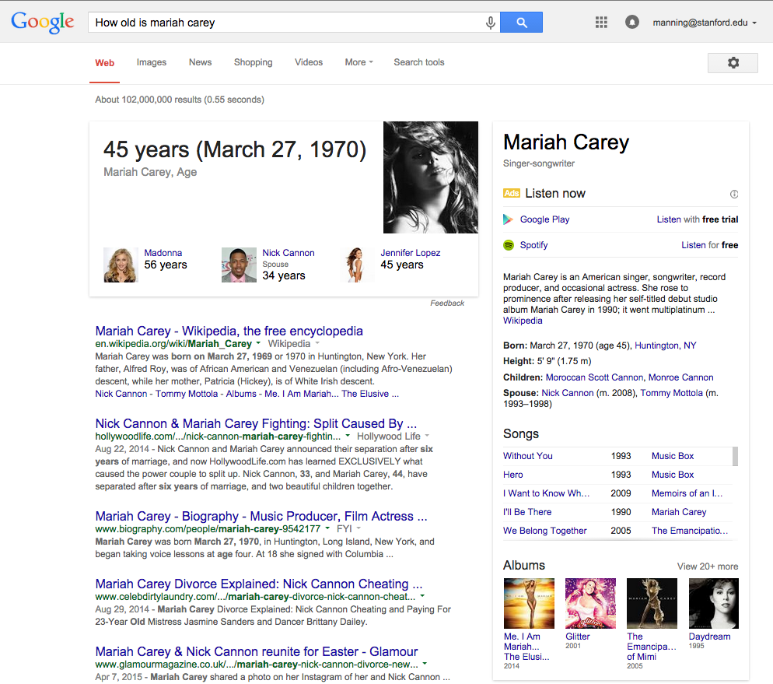
Structured Data
Direct Answer

Slide 45
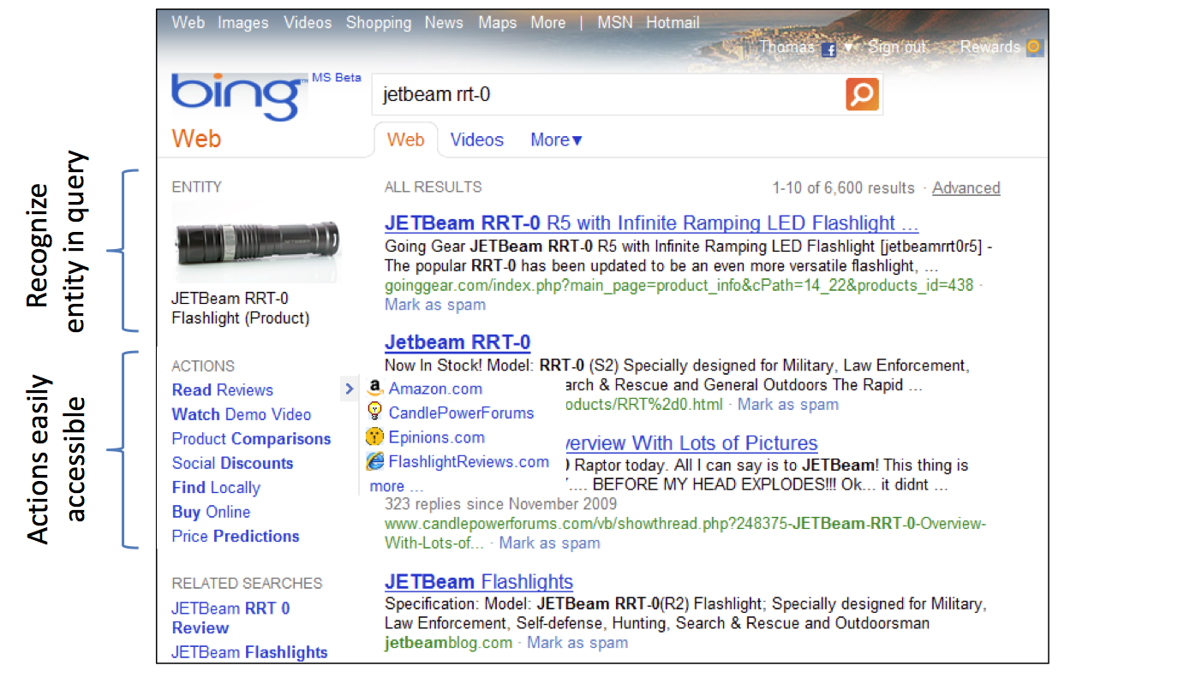
Desired experience: Towards actions (Patrick Pantel, et al., Microsoft Research)

Slide 46
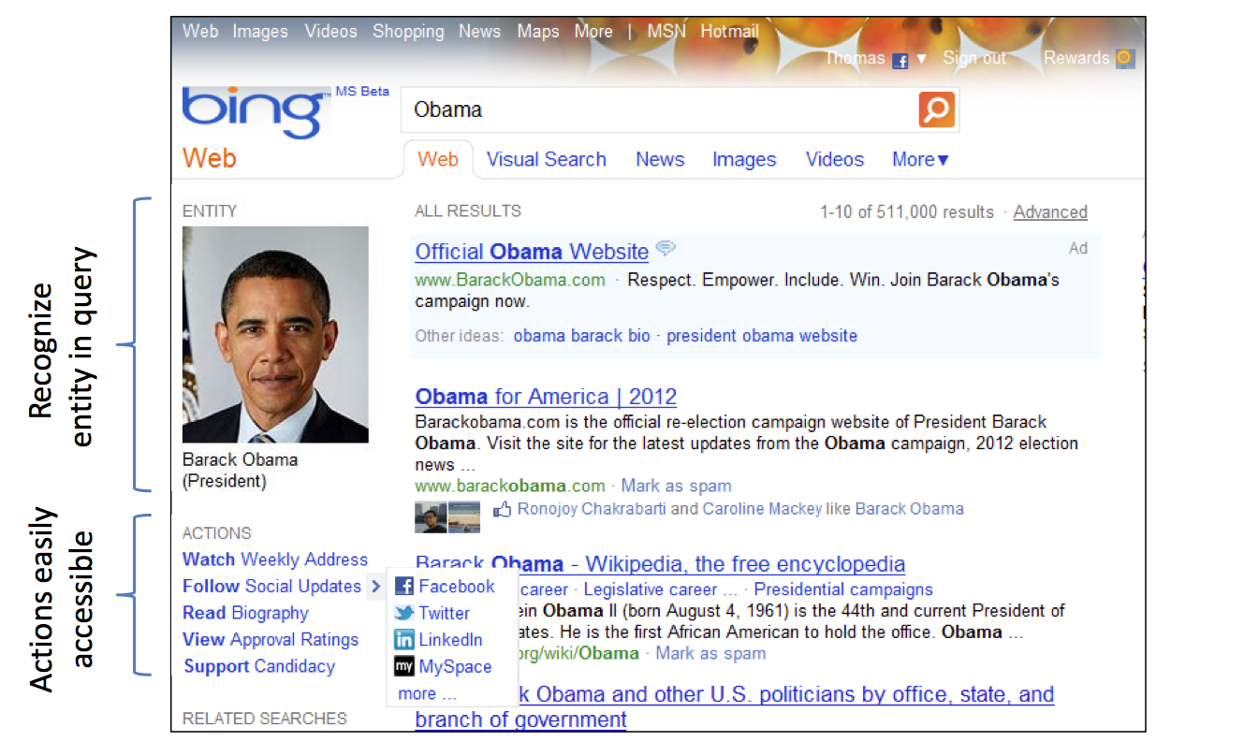
Desired experience: Towards actions

Slide 47
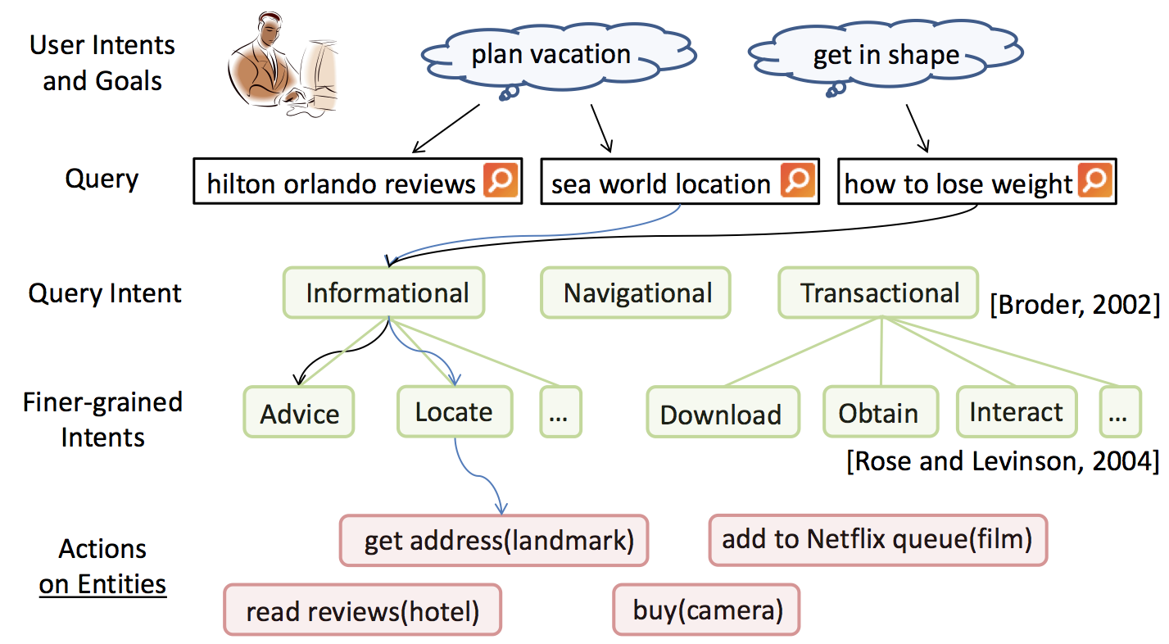
Actions vs. Intents

Slide 48
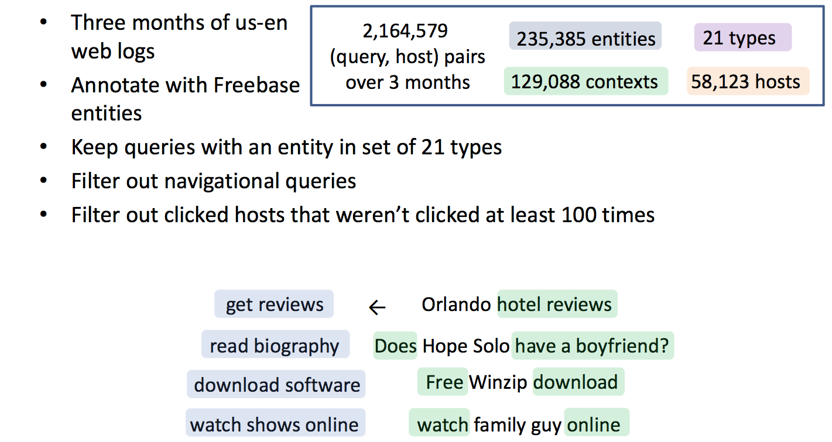
Learning actions from web usage logs
Notes:
Goes off to build probabilistic models that I won’t show….

Slide 49
The Facebook Graph
Collection of entities and their relationships
Entities (users, pages, photos, etc.) are nodes
Relationships (friendship, checkins, tagging, etc.) are edges
Nodes and edges have metadata
Nodes have a unique id – the fbid

Slide 50
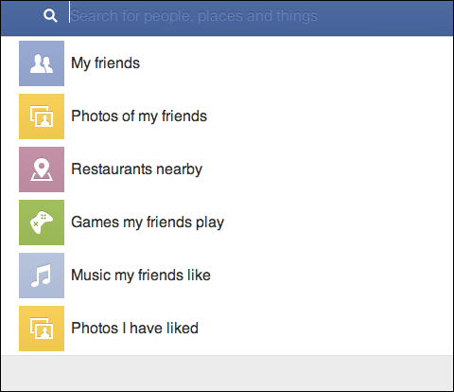
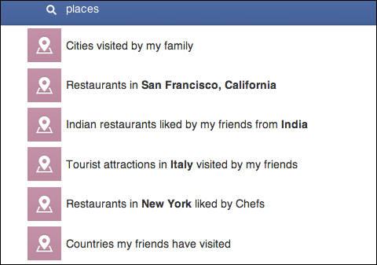
Facebook Graph Search

Slide 51
Facebook Graph Snippet
EVENT
fbid: 213708728685 type: PAGE name: Breville mission: To design the best … …
LIKES
FRIEND
TAGGED
fbid: 586206840 type: USER name: Sriram Sankar …
PHOTO

Slide 52
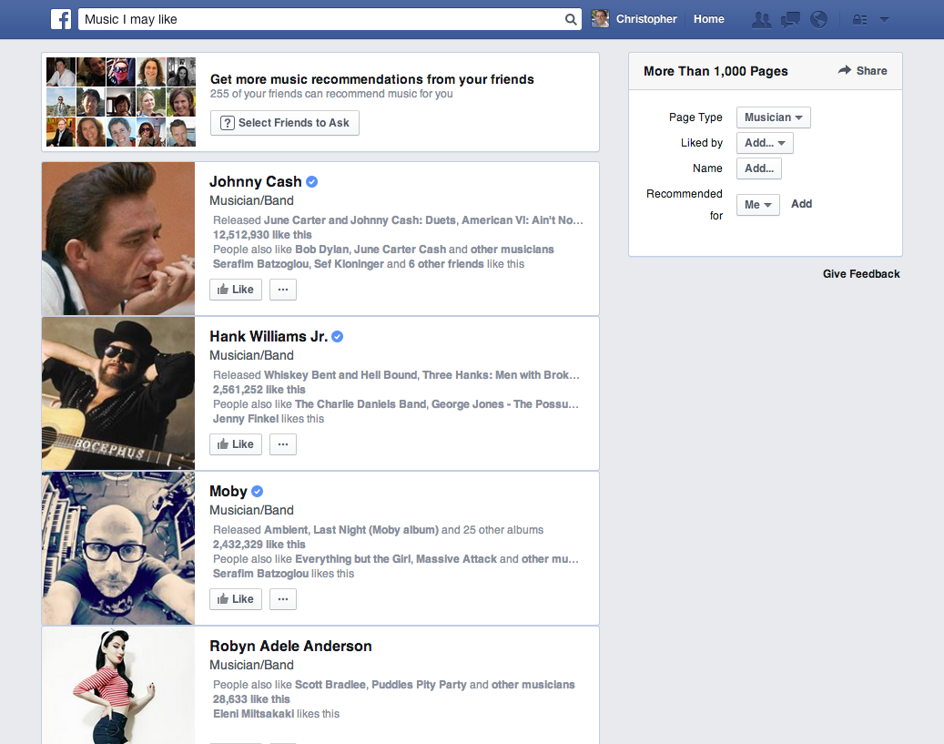
Social search/QA

Slide 53
Facebook Graph Search
Uses a weighted context free grammar (WCFG) to represent the Graph Search query language:
[start] => [users] $1
[users] => my friend friends(me)
[users] => friends of [users] friends($1)
[users] => {user} $1
[start] => [photos] $1
[photos] => photos of [users] photos($1)
A terminal symbol can be an entity, e.g., {user}, {city}, {employer}, {group}; it can also be a word/phrase, e.g., friends, live in, work at, members, etc. A parse tree is produced by starting from [start] and expanding the production rules until it reaches terminal symbols.
https://www.facebook.com/notes/facebook-engineering/under-the-hood-the-natural-language-interface-of-graph-search/10151432733048920
http://spectrum.ieee.org/telecom/internet/the-making-of-facebooks-graph-search

Slide 54
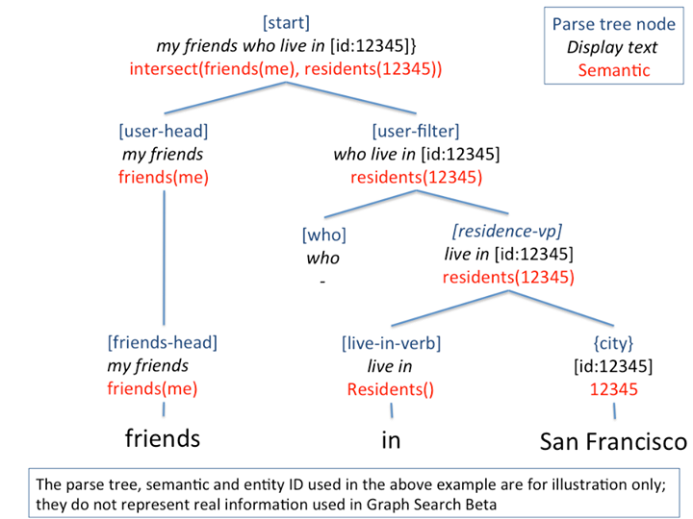
Notes:
If outside grammar, you fall back to a Bing search

Slide 55
